Slide 1
Unit2 My favourite colour is yellow.

Slide 2
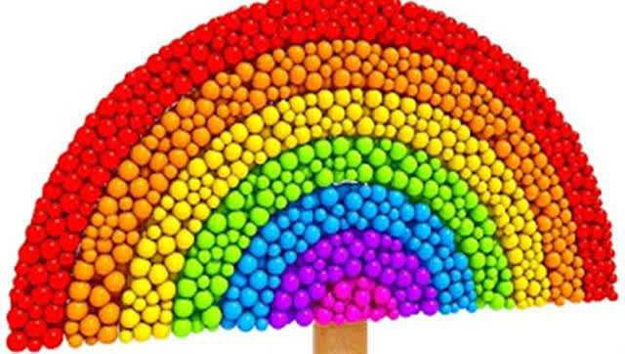
What colour（颜色）can you see?
red 红
orange 橙
yellow 黄
green 绿
blue 蓝
purple 紫
pink 粉红

Slide 3
favourite

Slide 4
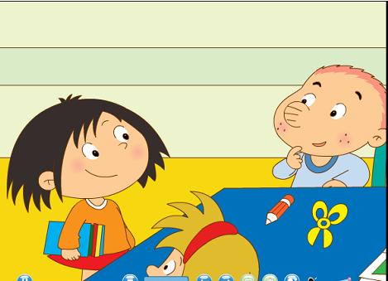
Lingling
Sam

Slide 5
What's Sam's favourite colour?
Yellow.

Slide 6
Pair work
--What's your favourite colour?
--My favourite colour is yellow.

Slide 7
Fill, listen and answer.
--What’s your favourite colour?
--My favourite colour is _______.
yellow

Slide 8
--What’s your favourite colour?
--My favourite colour is _______.
green

Slide 9
--What’s your favourite colour?
--My favourite colour is _______.
blue

Slide 10
Listen and match

Slide 11
Homework：
1.课后调查同学最喜欢的颜色。
2.向家人展示自己跟读模仿课文录音的情况。

