Slide 1
Module 5 Unit 1
Can you run fast?

Slide 2
Let’s chant
Swim swim swim I can swim I can swim.
Swim swim swim I am swimming now.
Jump jump jump I can jump I can jump.
Jump jump jump I am jumping now.
Fly fly fly I can fly I can fly.
Fly fly fly I am flying now.
Run run run I can run I can run.
Run run run I am running now.

Slide 3
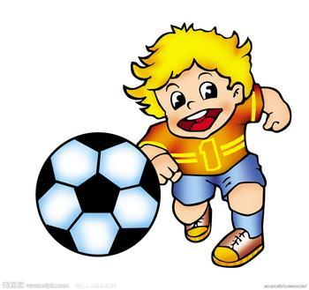
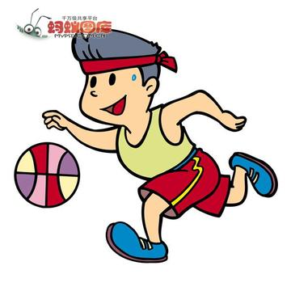
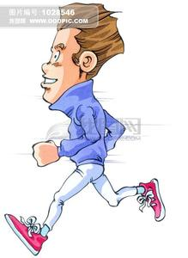
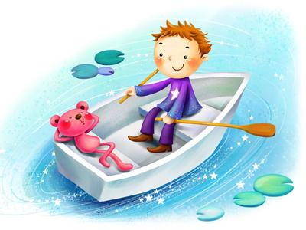
A brain storm
play basketball
play football
run fast
row a boat

Slide 4
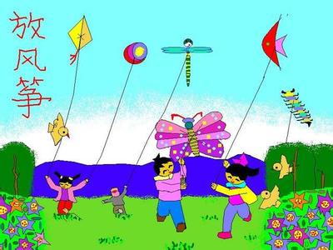
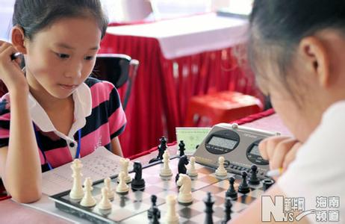
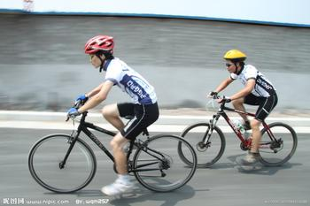
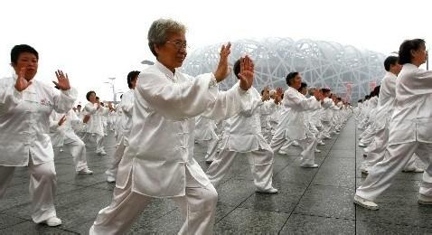
play chess
fly a kite
do taijiquan
ride a bike

Slide 5
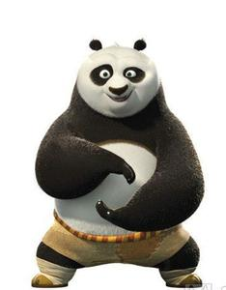
Can you ....?
Yes,I can.
No,I can't.
Notes:
PPT模板：www.1ppt.com/moban/ PPT素材：www.1ppt.com/sucai/
PPT背景：www.1ppt.com/beijing/ PPT图表：www.1ppt.com/tubiao/
PPT下载：www.1ppt.com/xiazai/ PPT教程： www.1ppt.com/powerpoint/
资料下载：www.1ppt.com/ziliao/ 范文下载：www.1ppt.com/fanwen/
试卷下载：www.1ppt.com/shiti/ 教案下载：www.1ppt.com/jiaoan/
PPT论坛：www.1ppt.cn PPT课件：www.1ppt.com/kejian/
语文课件：www.1ppt.com/kejian/yuwen/ 数学课件：www.1ppt.com/kejian/shuxue/
英语课件：www.1ppt.com/kejian/yingyu/ 美术课件：www.1ppt.com/kejian/meishu/
科学课件：www.1ppt.com/kejian/kexue/ 物理课件：www.1ppt.com/kejian/wuli/
化学课件：www.1ppt.com/kejian/huaxue/ 生物课件：www.1ppt.com/kejian/shengwu/
地理课件：www.1ppt.com/kejian/dili/ 历史课件：www.1ppt.com/kejian/lishi/

Slide 6
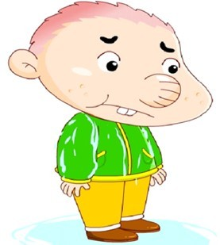
Listen and answer:
1.How many sports can you hear(听到)? What are they?
I can hear______.
They are_______.

Slide 7
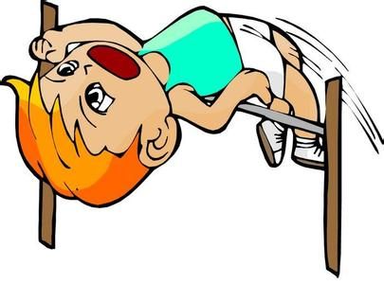
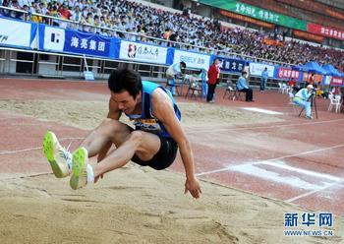
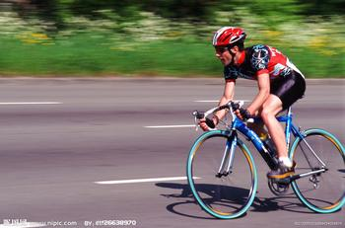
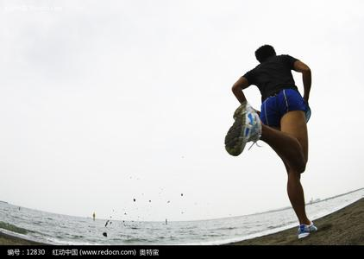
Check the answers:
run fast
jump high
ride fast
jump far

Slide 8
Let's look at Picture 1--2
Can Amy run fast?
No, she can’t.
Who is the winner?
Sam.

Slide 9
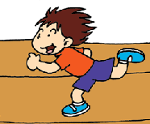
Can you ...?
Yes, I can.
No, I can't.
run fast

Slide 10
Picture 3--4
Can Sam jump high?
Yes ,he can.
Can Daming jump high?
No, he can’t.
Who is the winner?
Sam.

Slide 11
jump high
Can you ...?
Yes, I can.
No, I can't.

Slide 12
Picture 5--6
What does Lingling ask?
Can you jump far,Sam？
Who is the winner?
Sam.

Slide 13
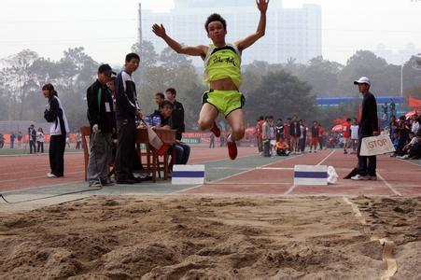
jump far

Slide 14
Can you…
jump far
Yes, I can.
No, I can't.

Slide 15
Picture 7--8
What does Daming ask?
Can you ride fast,Sam?
Can Sam win this time?
No, he can’t.

Slide 16
Say the chant:
Can you run fast? Can you run fast?
Yes,I can,yes,I can.
Can you jump high? Can you jump high?
Yes,I can,yes,I can.
Can you jump far? Can you jump far?
Yes,I can,yes,I can.
Can you ride fast? Can you ride fast?
No, I can't. No, I 'm afraid I can't.

Slide 17
Survey: Can you ...?
 | run | run fast | jump high | jump far | play football | play basketball
Can
can't
On sports Day, I can __.

Slide 18
Can you ...?
 | run | run fast | jump high | jump far | play football | play basketball
Can | √
can't |  | √
On sports Day, I can run.
I can’t run fast.

Slide 19
Homework
1、read and try to act out the story.
2、Finish writing what you can do and can't do.

Slide 20
Thank you ,bye-bye!

