Slide 1
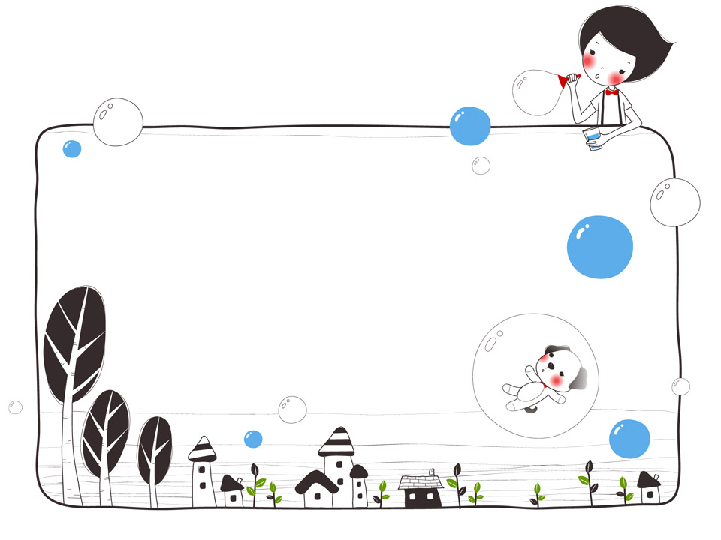
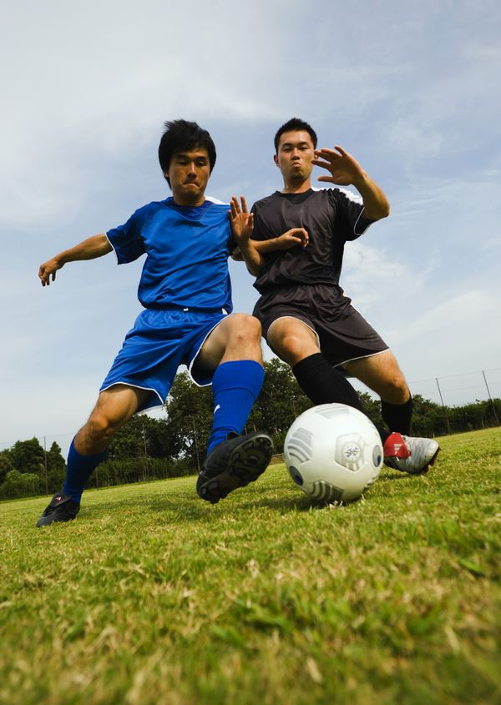
Pair-work
Talk about your weekend

Slide 2
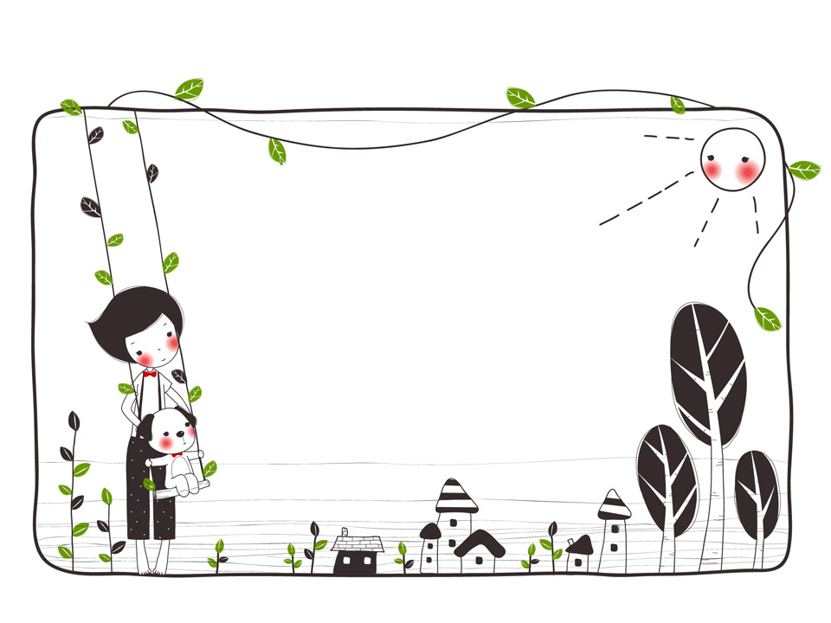
Exercise
根据汉语意思完成句子。
我每天锻炼两次
I do exercise _______ ______ _______.
2. 我堂弟每周打一两次篮球。
My cousin plays basketball _____ _____ ______ a week.
3. ——你多久逛一次街？
——我经常逛街。
______ ______ do you go shopping?
I ______ go shopping.
4. 我从不玩电脑游戏。
I _______ play computer game.
5. 学生总是写作业。
Students ______ do homework.
twice a day
once or twice
How often
often
never
always

Slide 3
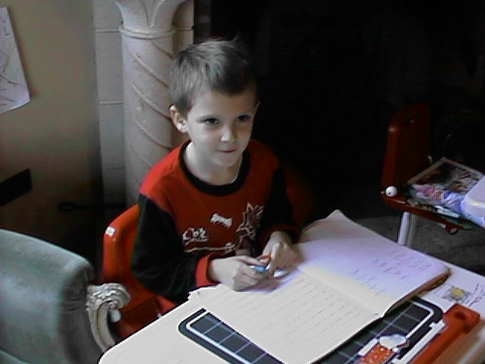
do homework
every day
A: How often do you do your homework?
B:_________________________________
I do my homework every day.

Slide 4
do exercise
once a week
How often do you do exercise?
A:___________________________
B: I do exercise once a week.

Slide 5
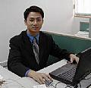
use the Internet
twice a week.
A: How often does he use the Internet?
B: ______________________________
He uses the Internet twice a week.

Slide 6
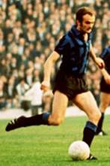
play football
four times a month
A: _____________________________
B: He plays football four times a month.
How often does he play football?

Slide 7
go to KFC
once a week
A: How often does she go to KFC?
B:___________________________
She goes to KFC once a week.

Slide 8
go to the beach
once a month
A: How often do they go to the beach?
B:___________________________
They go to the beach once a month.

Slide 9
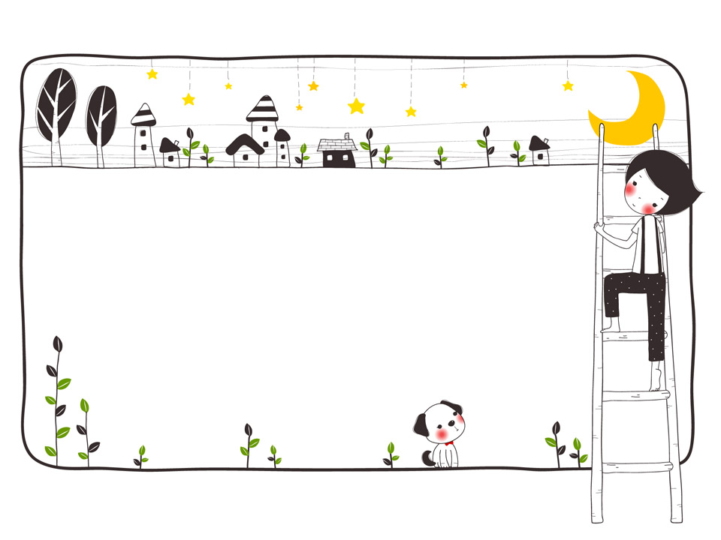
Thank you！

