Slide 1
&
how
many
how
much

Slide 2
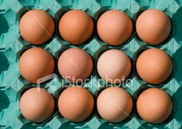
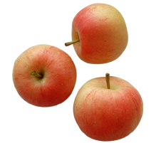
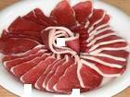
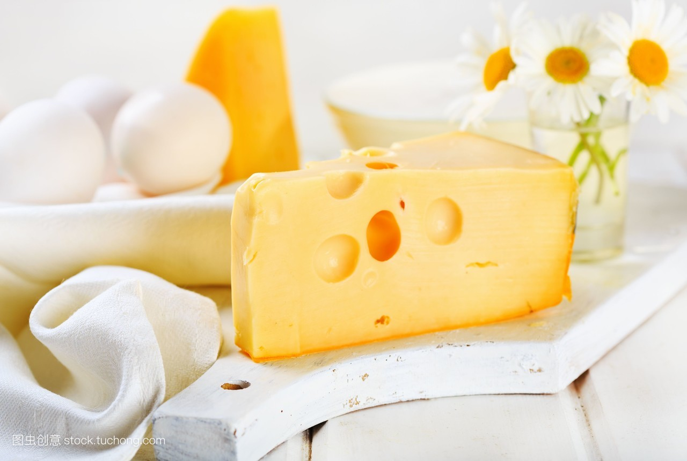
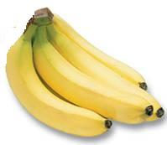
how many与how much的定义及区别
how many与 how much 都可以对数量进行提问，表示“多少”，how many修饰可数名词的复数；how much 修饰不可数名词。
milk
eggs
how many
apples
how much
meat
bananas
cheese

Slide 3
提问句式
How many＋复数名词＋一般疑问句＋？
e.g.
How many apples did you buy ?
How many orangs did you buy ?
How many bananas did you buy ?

Slide 4
记忆口诀
how many在句首，可数名词复数跟着走，
一般疑问句紧相随，其他成分不要丢。

Slide 5
提问句式
How much＋不可数名词 ＋一般疑问句＋？
e.g.
How much milk did you buy ?
How much cheese did you buy ?
How much meat did you buy ?

Slide 6
记忆口诀
how much在句首,不可数名词跟着走，
一般疑问句紧相随，其他成分不要丢。

Slide 7
special uses
how much不仅可以询问数量“多少” ， 还可用来询问价格，译成“多少钱”。
How much is this pencil?
It's two yuan.
How much is this cap?
It's five yuan.

Slide 8
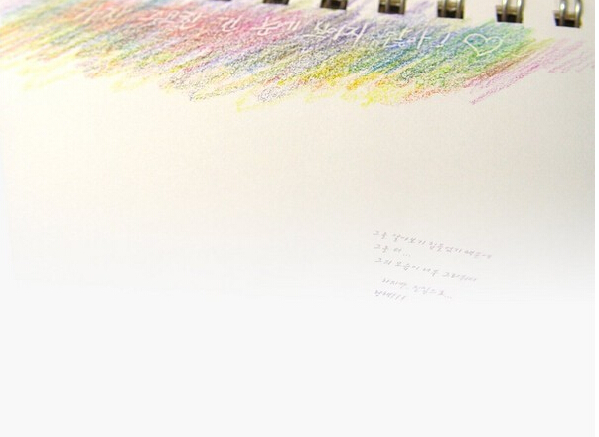
make choice questions
____meat did you buy?
A. How many B. How much C. How
2. ___pears are there?
A. How many B. What C. How much
3.
How much____ did you buy?
A. cakes B. cheese C. oranges
--____is this pen? --Two yuan.
A.How much B.How many C.How

