Slide 1
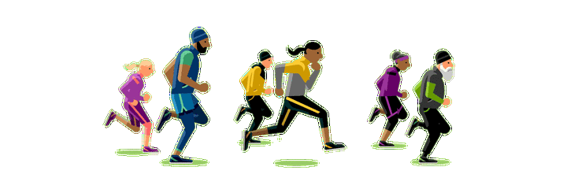
外研版新标准英语（三起）四年级上册
Module 5 Unit 1
Can you run fast?

Slide 2
I say you do.
我说你做。

Slide 3
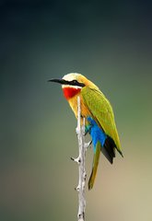
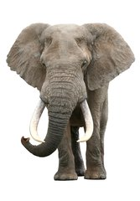
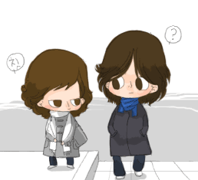
Little bird, little bird,can you clap?
No, I can't. No, I can't. I can't clap.
Little bird, little bird, can you fly?
Yes, I can. Yes, I can. I can fly.
Elephant, elephant, can you fly?
No, I can't. No, I can't. I can't fly.
Elephant, elephant, can you stomp?
Yes, I can. Yes, I can. I can stomp.

Slide 4
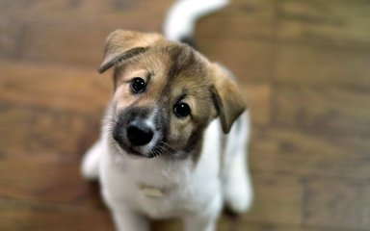
Little dog, little dog,can you ?
No, I can't. No, I can't. I can't .
Little dog, little dog, can you ?
Yes, I can. Yes, I can. I can .

Slide 5
I can…
我会...
我不会...
I can’t…
你会...吗？
Can you...?
是的，我会。
Yes, I can.
不，我不会。
No, I can't.

Slide 6
Homework:给家长展示自己编的歌
Little , little ,
can you ?
No, I can't. No, I can't.
I can't .
Little , little ,
can you ?
Yes, I can. Yes, I can.
I can .

Slide 7
We must admit that everyone has advantages
and disadvantages. We can not only look at the
disadvantages of others, in the contrast we
should find out the advantages of others. Only in this way, can we know our disadvantages and
learn from others.
我们得承认每个人都有长处和短处。我们不能只看到他人的短处，我们应该找到他人的长处。只有这样，我们才能认识到自己的短处并向他人学习。

