Slide 1

Module5
Unit1 How many?

Slide 2
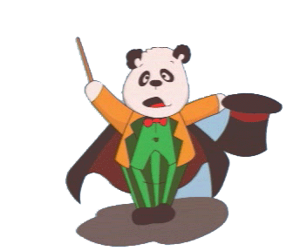

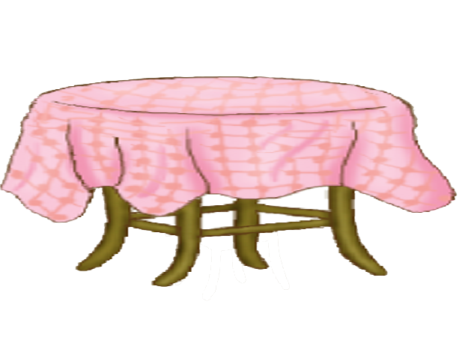





How many ?

Slide 3

O n e

Slide 4

T w o

Slide 5

T h r e e

Slide 6

F o u r

Slide 7


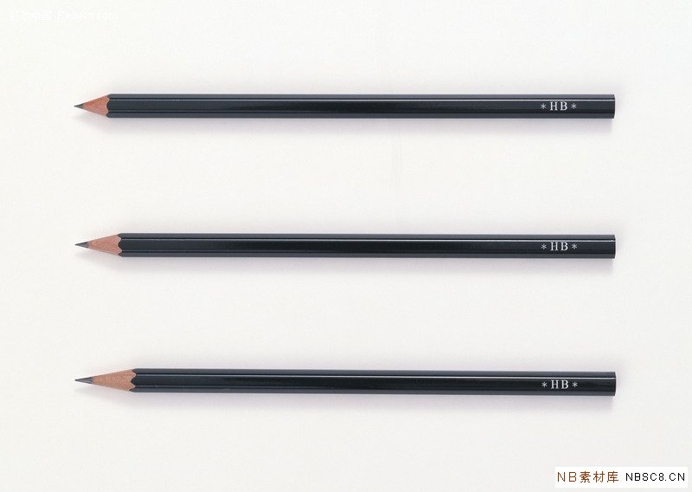
one
two
three
four

Slide 8

How many?
five
five

Slide 9

How many?
?
six

Slide 10

How many?
?
seven

Slide 11

How many ?
?
eight

Slide 12


How many?
One.
Two.
Three.
Four.
Five.
six,
Seven,
Eight.

Slide 13

Magic Cards （魔法牌）
one
seven
six
five
four
two
eight
three

Slide 14








one
two
six
four
three
five
seven
eight

Slide 15
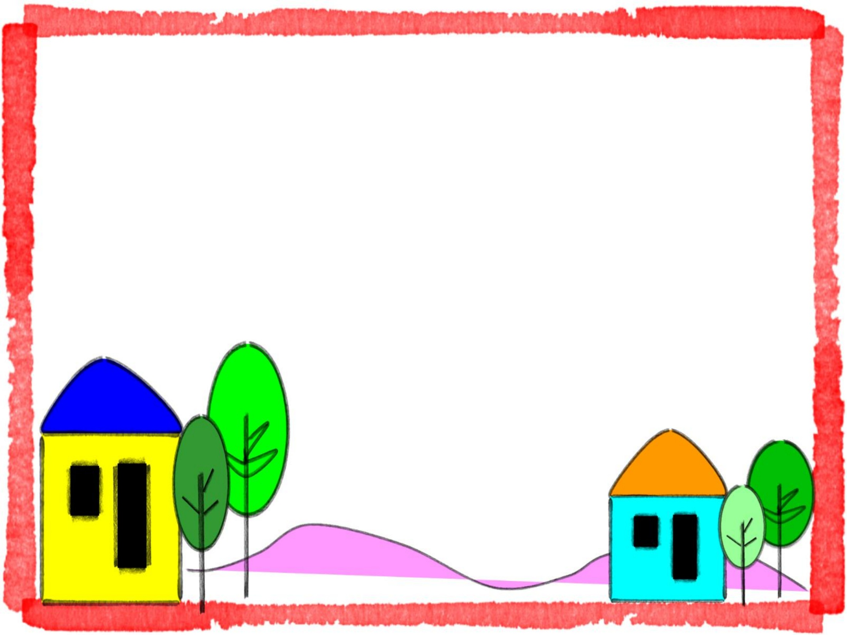
Homework:
Count the number from one to four.
（从一数到八）
Tell your parents some telephone numbers.
(用英文告诉家长自己家和朋友家的电话号码 )

Slide 16

Let's sing a song .
Ten little fingers

Slide 17


