Slide 1
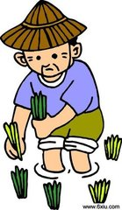
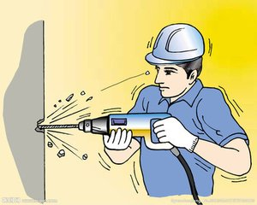
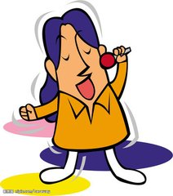
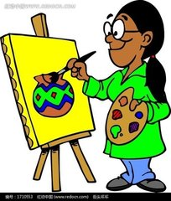
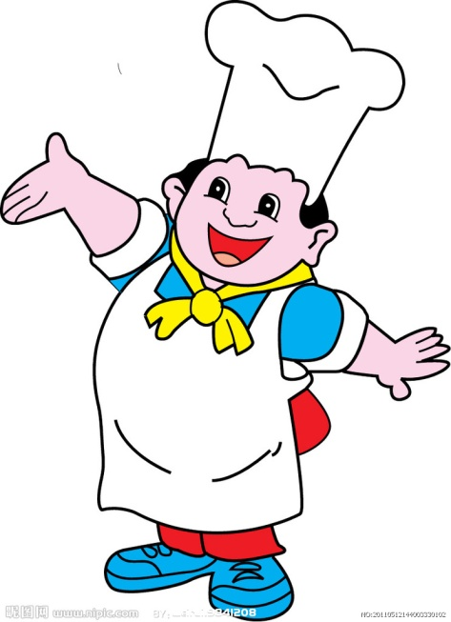
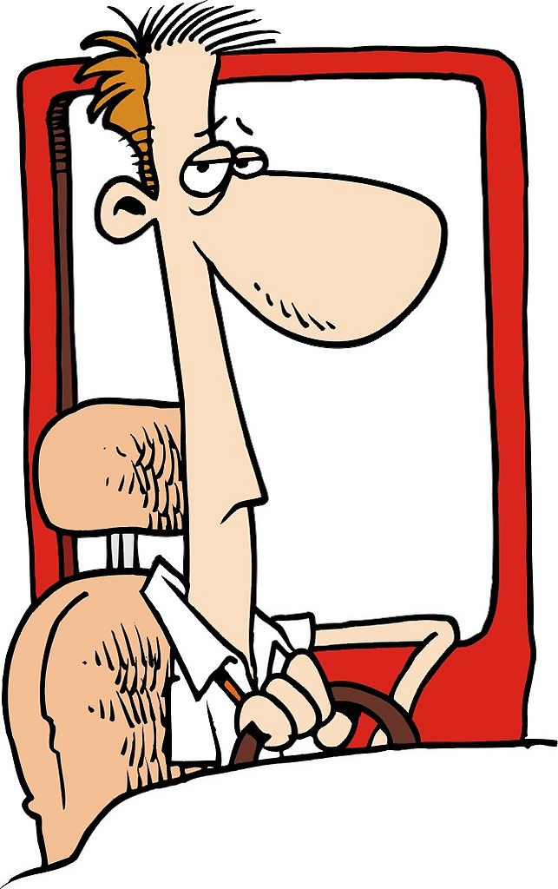
Module 9 Unit 2
painter
singer
farmer
worker
He’s a doctor.
cook
driver
doctor
policeman

Slide 2
Practice
4. police an
1. do tor
2. far er
5. teach r
3. dr ver
6. n rse

Slide 3
Homework
1.Talk about your families’ jobs.
2.Talk about your dream with your
partners.

