Slide 1
I can match
A . one
B. two
C. three
D. four
E. five
F. six
G. seven
H. eight

Slide 2
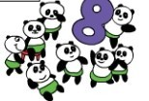
one
two
six
four
three
five
seven
eight

