Slide 1
Module 9
Unit 2 He's a doctor

Slide 2
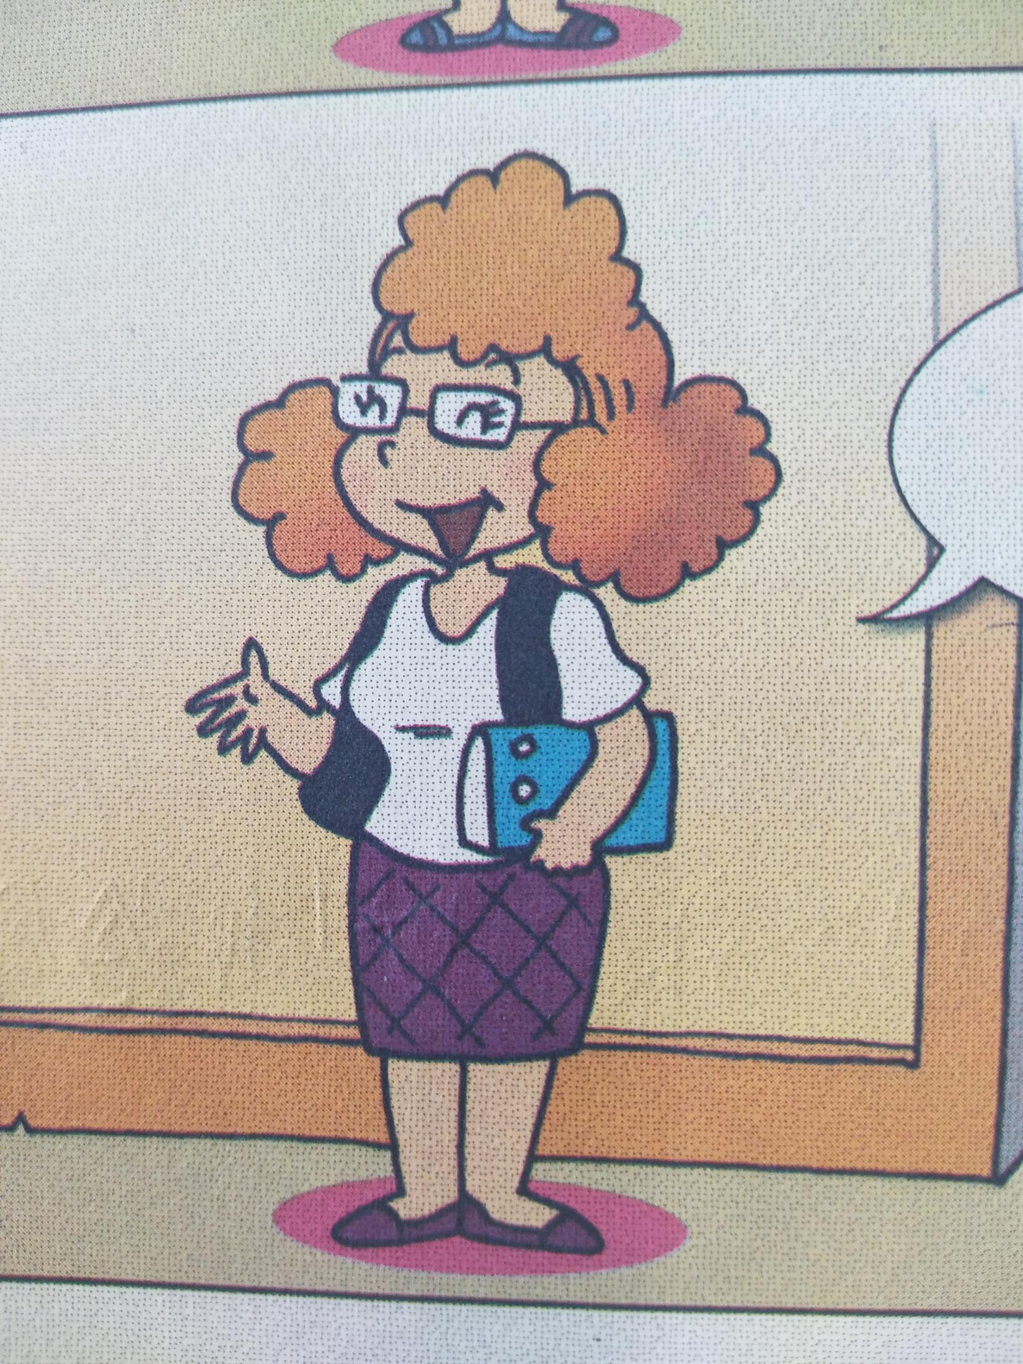
Guess: Who is she?

Slide 3
What is she?
She's a teacher

Slide 4
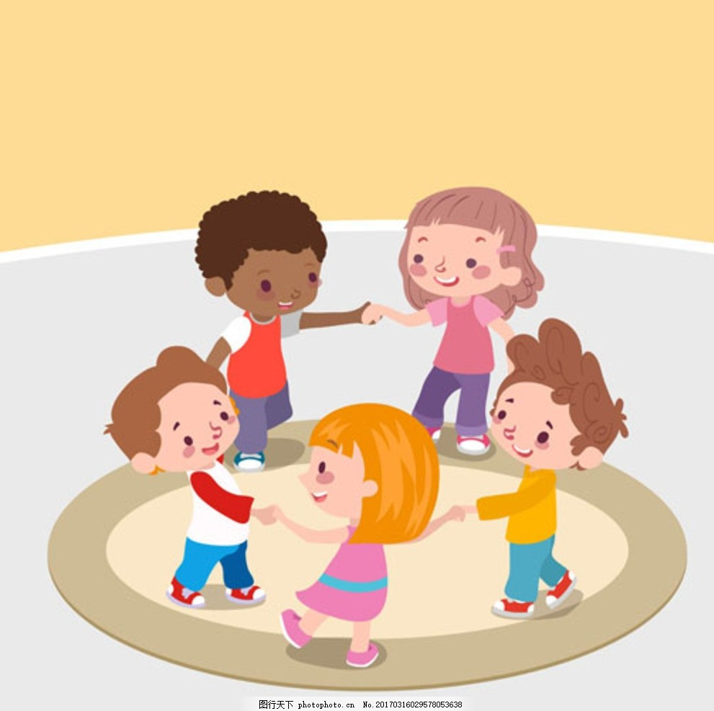
Game:
look at the pictures and guess:
what is he / she ?

Slide 5
doctor
医生

Slide 6
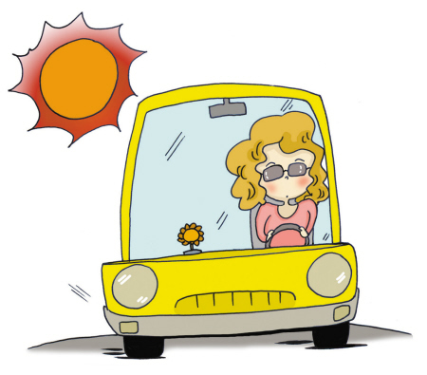
driver
司机

Slide 7
policeman
警察

Slide 8
nurse
护士

Slide 9
farmer
农 民

Slide 10
teacher
教 师

Slide 11
Game :
请一个同学到前面来做一个或者几个动作 ，剩下的同学请你们猜猜他/她所模仿的职业是什么？

Slide 12
He ' s a
doctor.

Slide 13
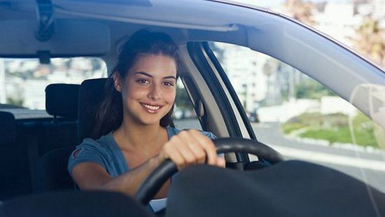
driver.
She 's a

Slide 14
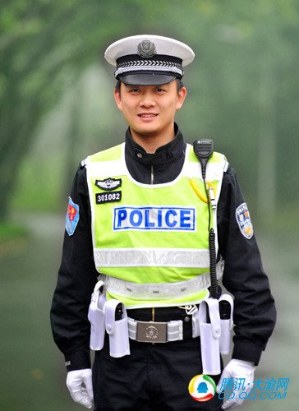
He 's a
policeman .

Slide 15
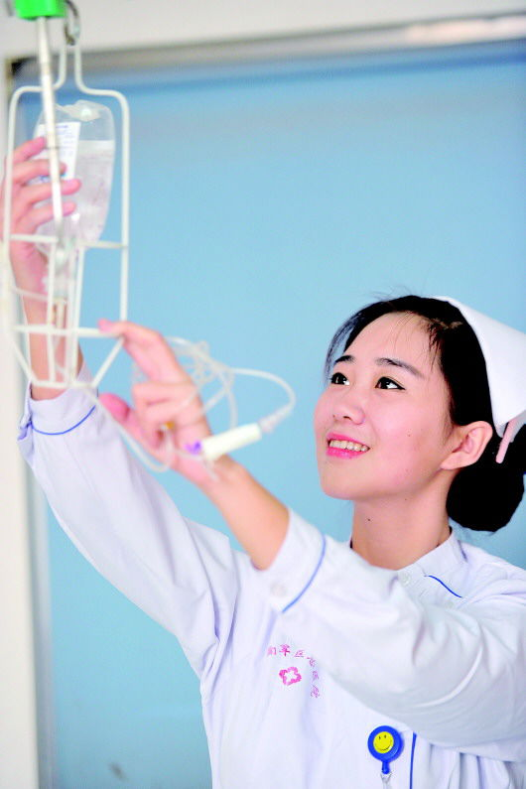
She 's a
nurse.

Slide 16
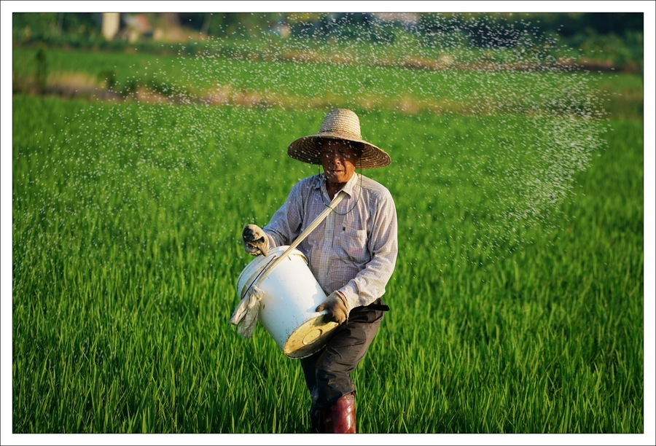
He 's a
farmer.

Slide 17
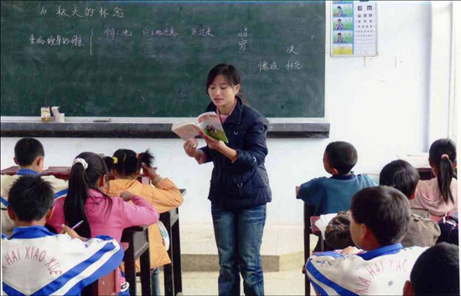
She ' s a
teacher.

Slide 18
说说自己的梦想？
I want to be a...

