Slide 1
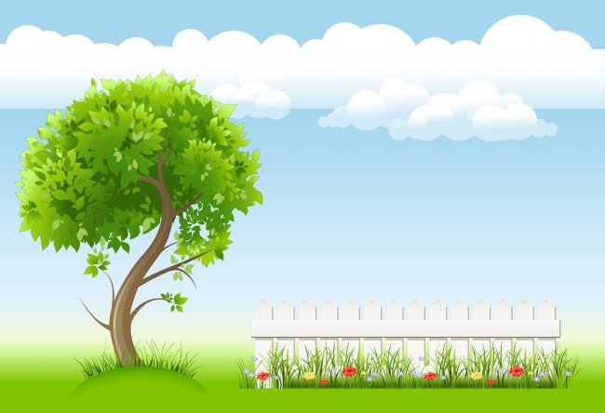
Be going to

Slide 2
We're going to visit Hainan.
We're going to get up at 5 o'clock.
I'm going to visit my grandma.
I'm going to swim now.

Slide 3
Be going to
be going to 是一般将来时的基本结构，表示在将来的时间将要或打算要做的事。
它通常与表示将来的时间一起连用，比如本课出现的tomorrow。

Slide 4
Be going to
am
is
are
I 用am ，you用are，
is用于她它他（she he it），
单数is，复数are。

Slide 5
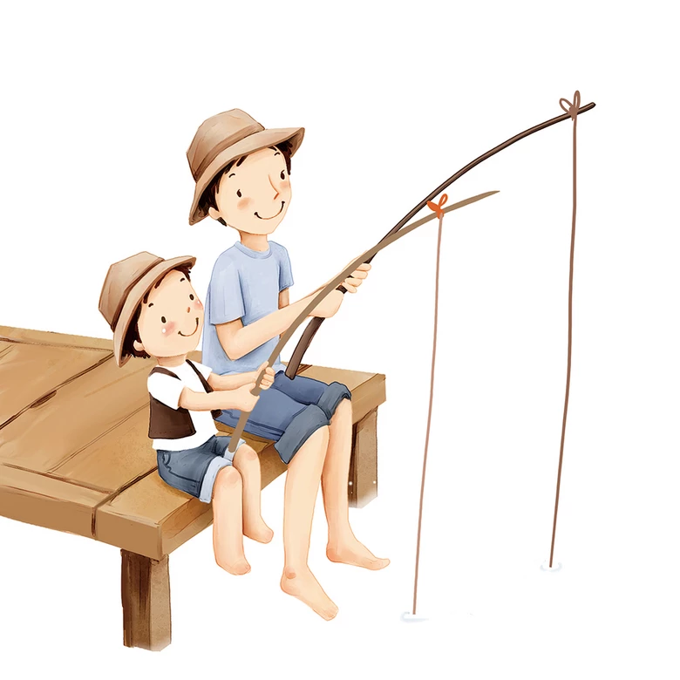
I __ going to go fishing tomorrow.
am

Slide 6
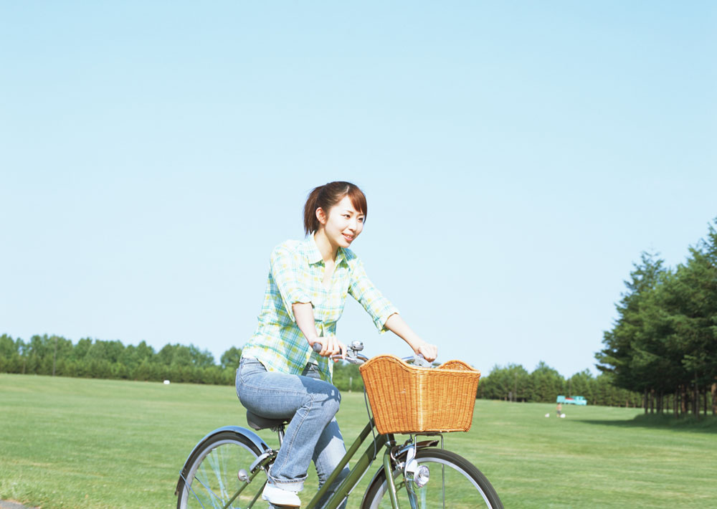
She ______ to ride a bike tomorrow.
is going

Slide 7
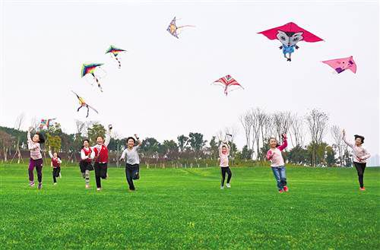
We _________ fly kites tomorrow.
are going to

Slide 8
I'm going to go fishing tomorrow.
she's going to ride a bike tomorrow.
We're going to fly a kite tomorrow.
Be going to 后面跟动词原形

Slide 9
Let‘s practice
1.They ___ going to swim after school.
A. am B.is C.are
C.are
2.Lingling __ going to visit her grandma on Saturday.
B.is
A. am B.is C.are

Slide 10
3. He's going to ___ some fruit.
A. eat
A. eat B.eats C.eating

Slide 11
1
Thank you!

