Slide 1
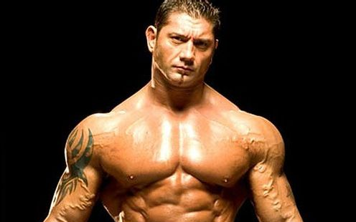

Slide 2
The usage between So & Such
Maggie Lee
2017-11-12

Slide 3
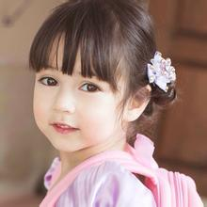
such a beautiful girl
She is such a beautiful girl.

Slide 4
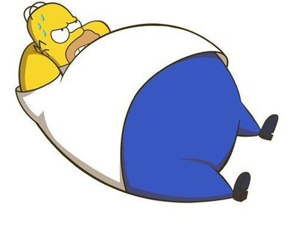
such a heavy man
He is such a heavy man.

Slide 5
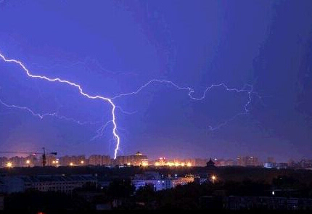
such terrible weather
It is such terrible weather.

Slide 6
1.) such + a (an) + adj. + 单数名词
such a cold day
such an old house
这是一个如此悲伤的故事。
It is such a sad story.

Slide 7
2.) such + adj. + 复数名词
他们是如此可爱的小孩子。
They are such lovely children.

Slide 8
3.) such + adj. + 不可数名词
such delicious food
such terrible news
这个男孩取得了如此大的进步。
This boy made such big progress.

Slide 9
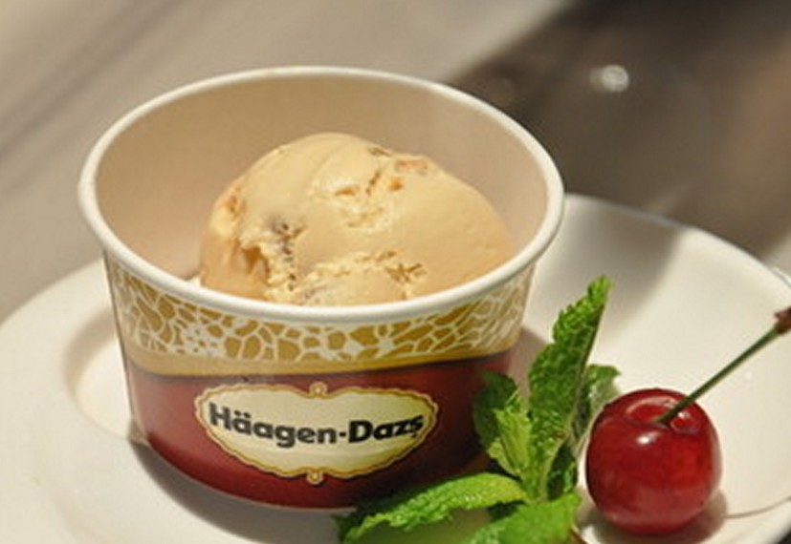
so delicious
Ice-cream is so delicious.

Slide 10
so fast
The man can run so fast.

Slide 11
so upset
Look at the boy, he is so upset.

Slide 12
so + adj. /adv.
so delicious
so quickly
这件外套的价格太高了。
The price of this coat is so high.

Slide 13
使用这两个词语时，需要注意以下两点：

Slide 14
1.）当that前是单数可数名词且该名词前面有形容词修饰时，so与such可以互换.
so + adj. + a/an + n. = such + a/an + adj. + n.
她是一位好老师。
She is so nice a teacher.
She is such a nice teacher.

Slide 15
2.) 当名词前出现表示数量多少的many, much, few, little等修饰时，只能用so，不能用such.
她拥有如此多的书籍。
She has so many books.
外面嘈杂声很大。
There is so much noise outside.

Slide 16
Exercise:
Fill in the blanks with “so” or “such”
The soccer match is ______ excited.
Our English teacher is ________ a friendly person.
That boy can jump ______ high.
This is _____ interesting a book.
This is _______ an interesting book.
We don’t have ____ much homework today.
so
such
so
so
such
so

Slide 17
II. Translate the sentences.
天气太好了。 （such）
这些书太重了。（so）
他学习非常努力。（so）
这部电影太有趣了。（such）

Slide 18
II. Translate the sentences. （Answer）
It was such great weather.
These books are so heavy.
He studies so hard.
It is such an interesting movie.

Slide 19
THANK YOU
谢谢观看
Made by Maggie

