Slide 1
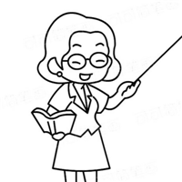
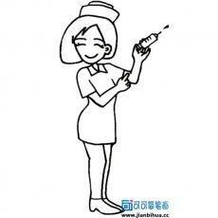
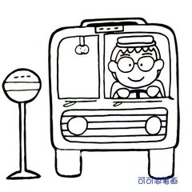
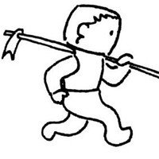
Match and say. She's a driver. He's a farmer. ① She's a nurse. He's a doctor. She's a teacher. He's a policeman.
A.
B.
C.
D.
E.
F.

