Slide 1
Spring Festival

Slide 2
Spring Festival
Spring Festival has always been regarded as the most important festival in China. Today we are going to learn more about it.

Slide 3
Before we start, close your eyes and think about anything that have something to do with the Spring Festival.

Slide 4
The outline
1.The date of Spring Festival
2.The legend of Spring Festival
3.Food
4.Chinese traditions
5.Some new year blessings

Slide 5
The date of Spring Festival
It is the 1st day of the 1st lunar
month.
The celebration lasts for 15
days.

Slide 6
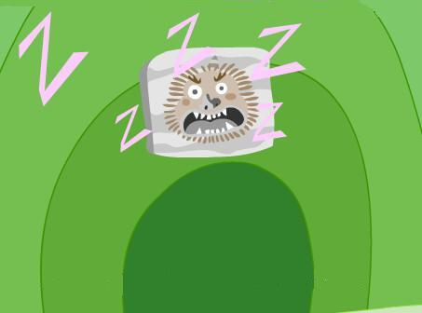
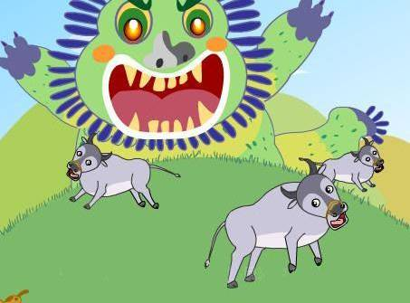
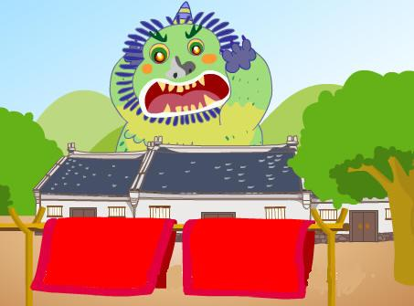
Legendary story about “Nian”
1. Once upon a time ,there lived a terrible beast called Nian. It stayed in the deep sea throughout the year.
2. It climbed up to the shore on the last day of lunar year to
eat people and animals.
3.One year, it was discovered that Nian was afraid of the loud noise and the color red.

Slide 7
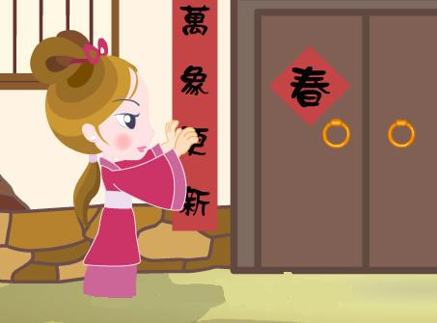
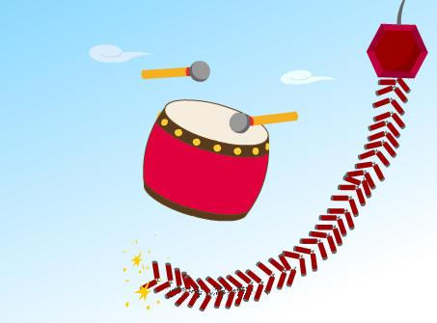
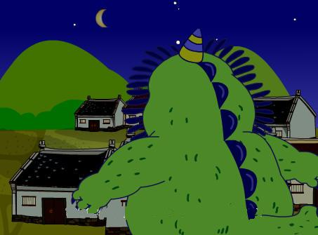
4. So，on that night, people set off firecrackers, stuck red paper on the door,
and hung red lantern in front of their houses.
5.By doing this, they had successfully frightened Nian away. And after that, this terrible creature had never come back. Since then, the Chinese had called this day Chuxi.

Slide 8
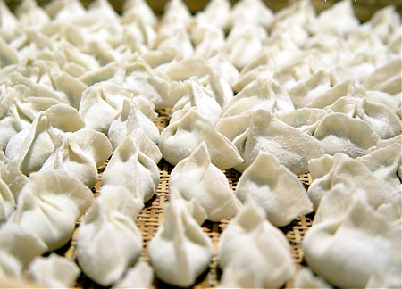
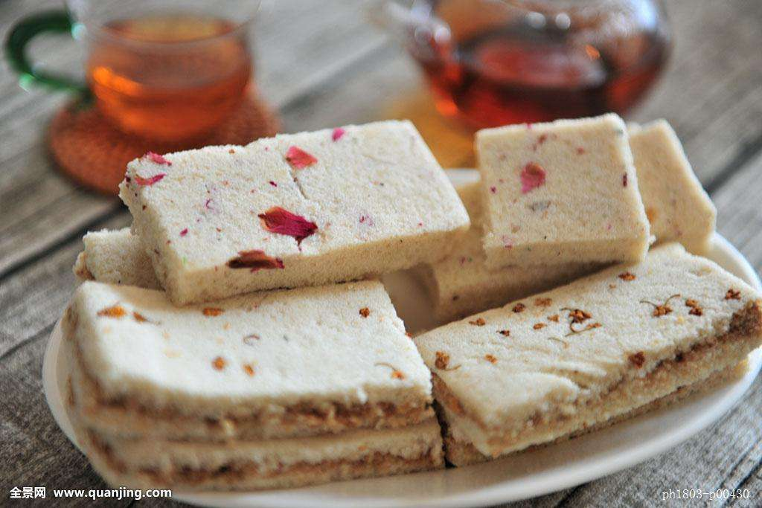
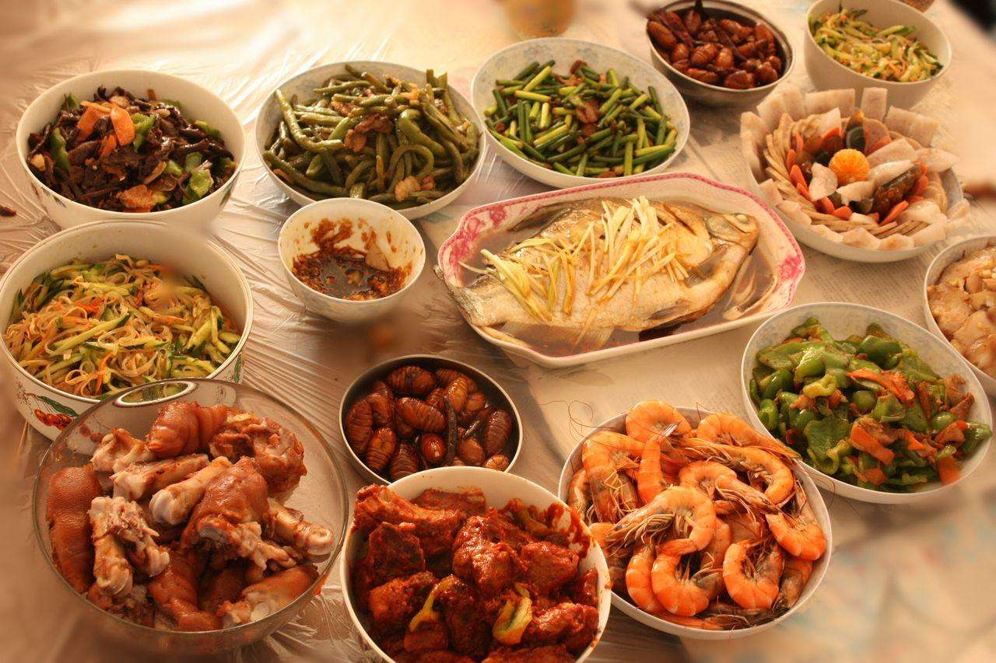
What do we eat?
In northern China
In southern China
No dumplings,
no Spring Festival.
“Gao” means tall, and wishes you higher and higher.
All Chinese have family reunion dinner.

Slide 9
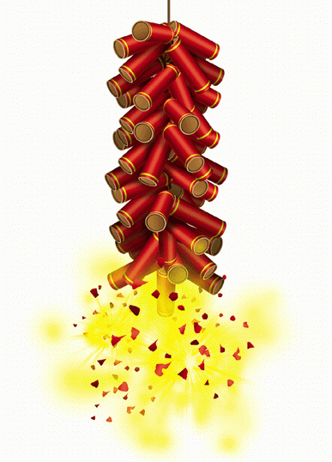
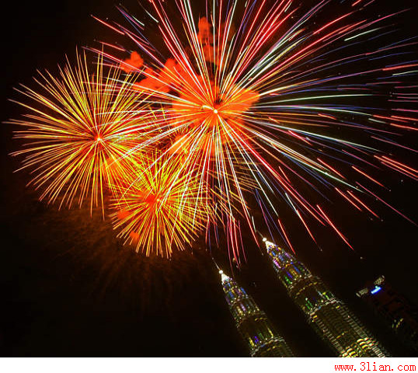
The tradition of Spring Festival
playing firecrackers

Slide 10
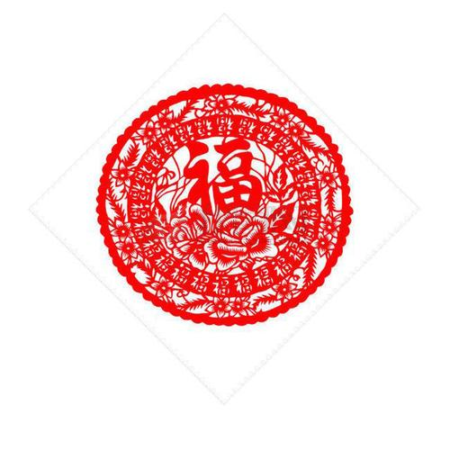
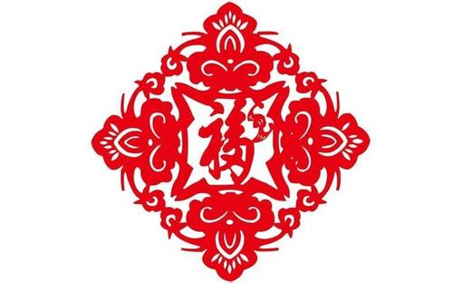
The tradition of Spring Festival
paper cutting

Slide 11
The tradition of Spring Festival
spring couplet

Slide 12
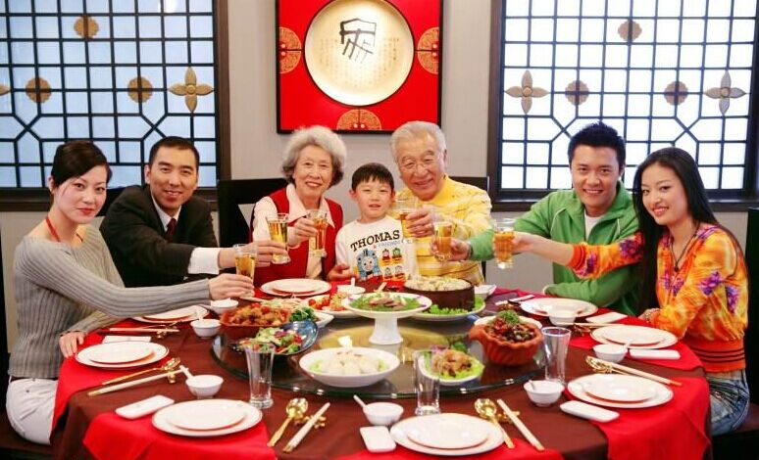
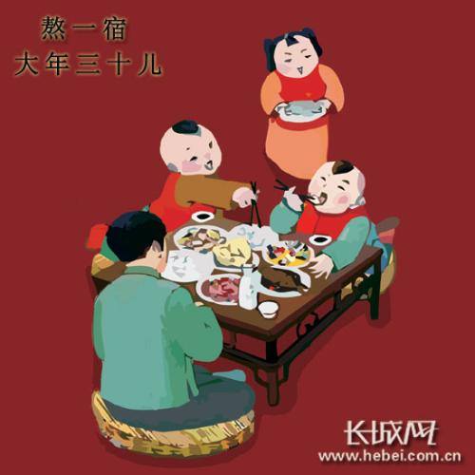
The tradition of Spring Festival
having a family reunion
staying up late
(“shousui”）

Slide 13
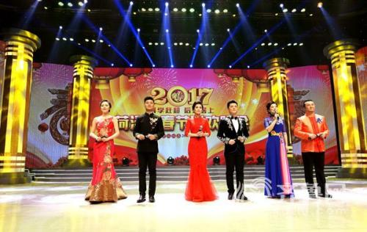
The tradition of Spring Festival
enjoying Spring Festival Gala

Slide 14
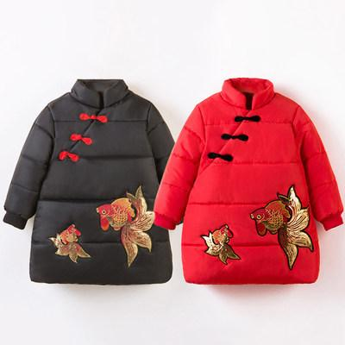
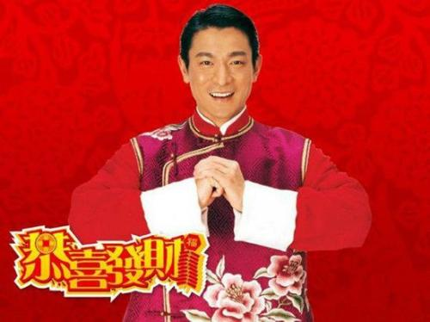
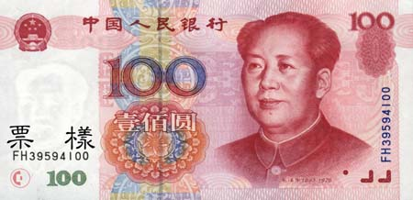
The tradition of Spring Festival
wearing new clothes
giving New Year's greetings
getting lucky money

Slide 15
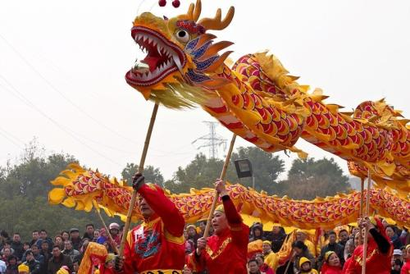
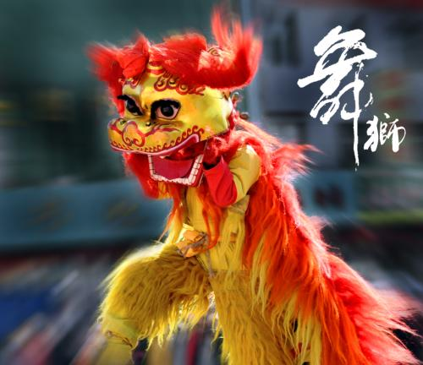
The tradition of Spring Festival
playing
dragon and lion dance

Slide 16
New year blessings
Peace all year round.
Wishing you prosperity.
May all your wishes come true.
Everything goes well.
Wish you happiness and prosperity in the coming year!

Slide 17
Spring Festival
The outline
1.The date of Spring Festival
2.The legend of Spring Festival
3.Food
4.Chinese traditions
5.New year blessings

Slide 18
Thank you.

